Slide 1
Apple's Analysis (AAPL)
School of Economics and Management
International Bachelor in Business and Economics
Saint-Petersburg 2025
Бегитова Кристина, Евдокимова Ксения

Slide 2
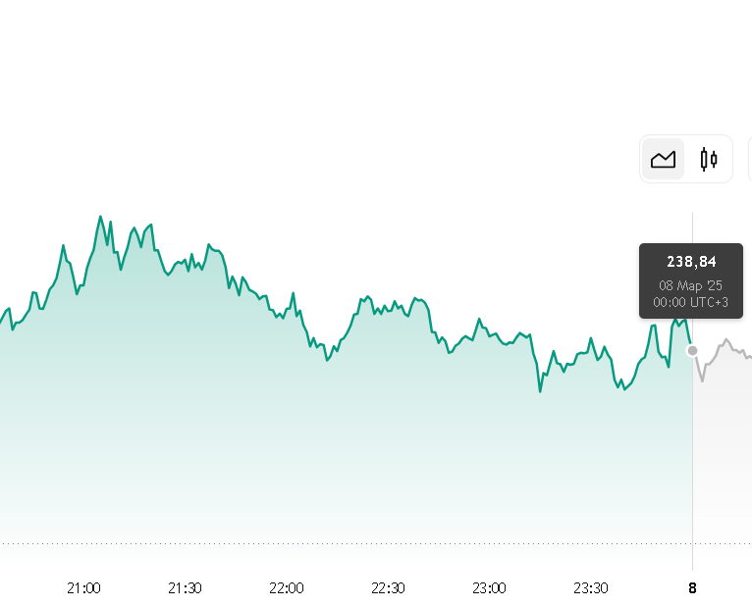
Summary about the company
School of Economics and Management
International Bachelor in Business and Economics
Saint-Petersburg 2025
Apple Inc. is an American multinational technology company, specializing in consumer electronics, software, and online services. Founded in 1976 by Steve Jobs, Steve Wozniak, and Ronald Wayne, Apple has grown to become the largest technology company by revenue, with $383.29 billion reported in 2023.
As of March 8, 2025, Apple’s stock (AAPL) is trading at $239.07, reflecting a 1.59% increase over the past 24 hours.
Source: https://ru.tradingview.com/symbols/NASDAQ-AAPL/

Slide 3
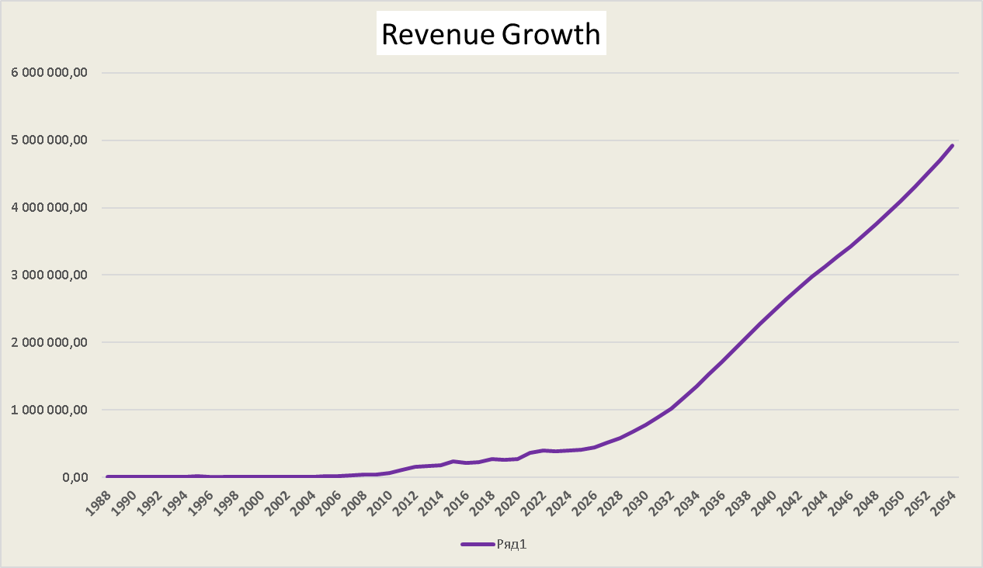
DDM-DM model – is used to value stocks by estimating the present value of expected future dividends.
School of Economics and Management
International Bachelor in Business and Economics
Saint-Petersburg 2025
Taking into account the accelerated growth of revenue due to development of AI and implementation in Apple products (15% in the first 10 years) and the subsequent gradual slowdown (from 10% to 5% by 2054).
This scenario takes into account a possible boom in AI technologies, but also assumes a natural slowdown in growth due to market saturation.

Slide 4
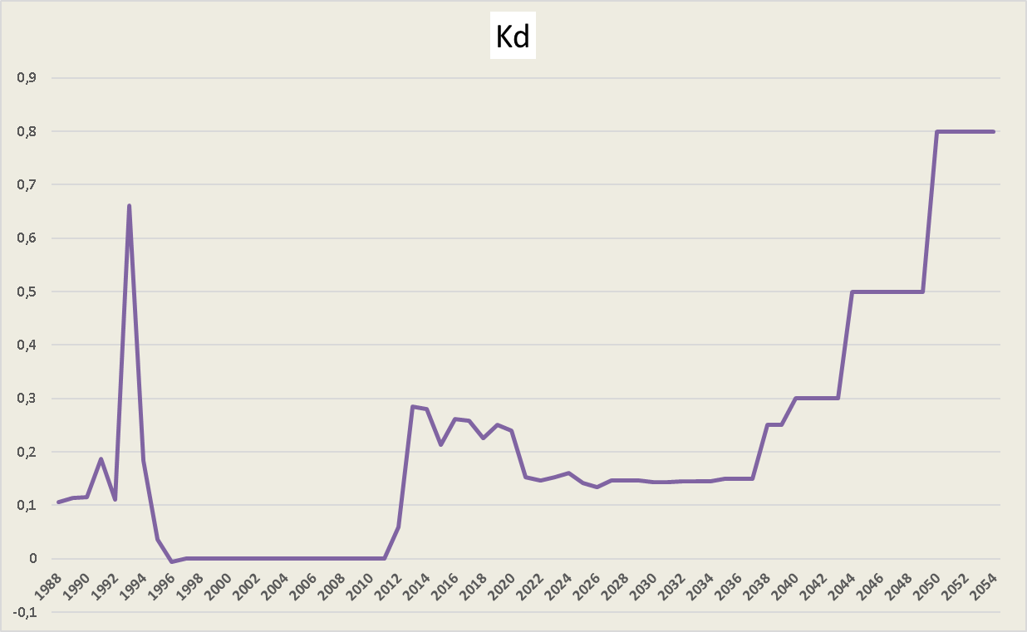
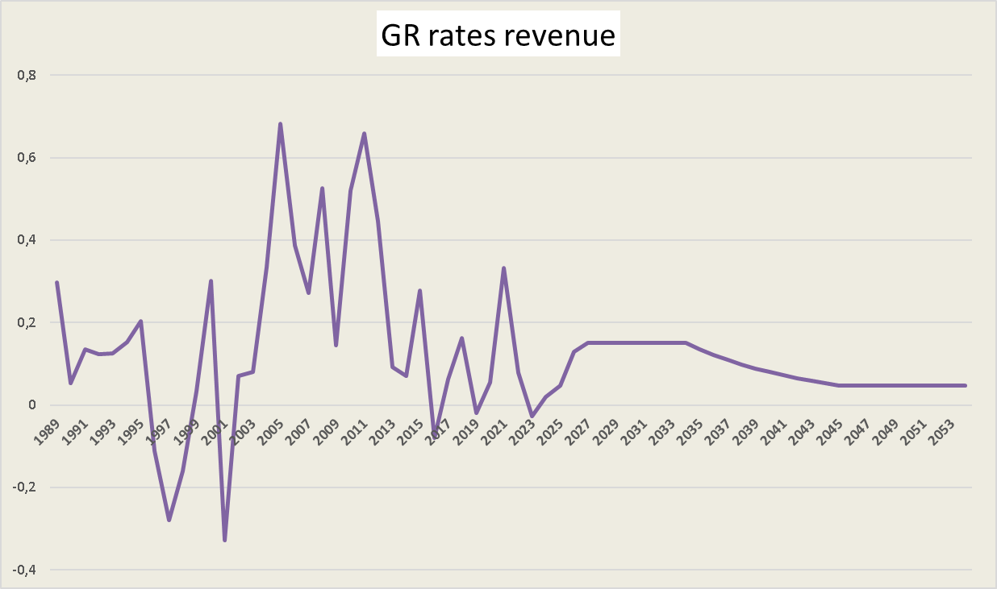
DDM-DM model – is used to value stocks by estimating the present value of expected future dividends.
School of Economics and Management
International Bachelor in Business and Economics
Saint-Petersburg 2025
Payout ratio predicted scenario for Apple (3 phases)
1. 2025-2034 (High Growth Phase - AI Boom)
• Revenue grows rapidly (+15% GR), but Apple reinvests heavily in AI and R&D.
• Payout ratio remains low (near 15%) to fuel innovation.
2. 2034-2044 (Mature Growth - Slowing GR)
• Revenue growth slows (13% → 6%) due to downturn of tech boom, and cash flow stabilizes.
• Payout ratio increases to ~30-40% as dividend payments become more attractive.
3. 2044-2054 (Saturation - Slow Growth)
• Revenue growth falls to 5% or less.
• Apple shifts toward a high payout model (50-80%), similar to mature dividend-paying companies today (for example, Microsoft).

Slide 5
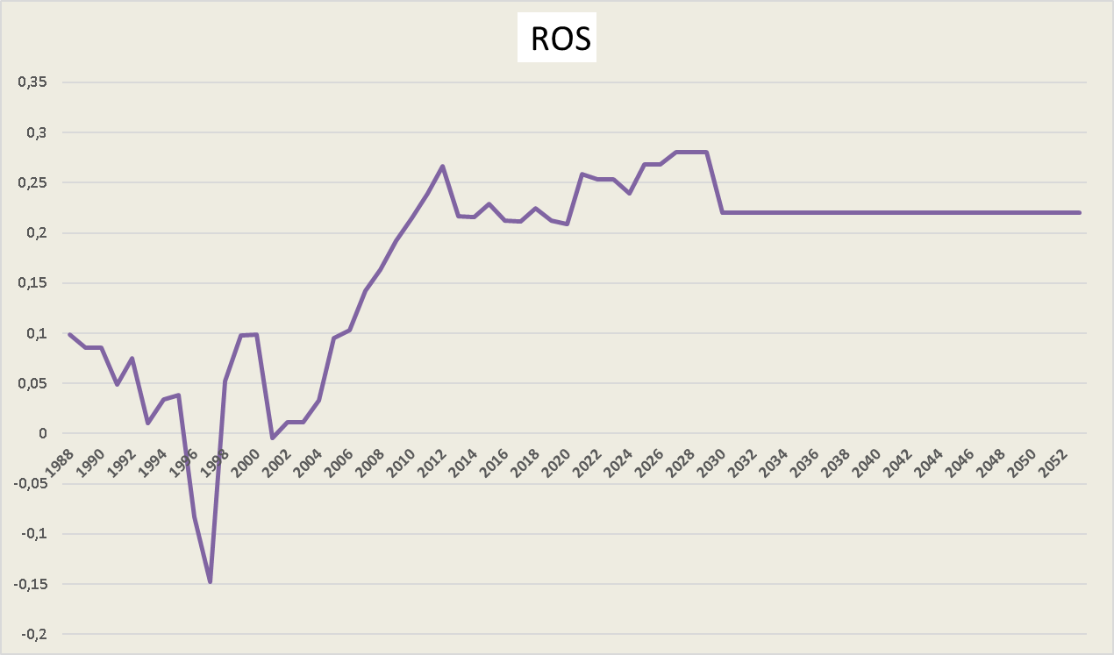
DDM-DM model – is used to value stocks by estimating the present value of expected future dividends.
School of Economics and Management
International Bachelor in Business and Economics
Saint-Petersburg 2025
ROS (Return on Sales)
Based on the data for recent 15 years, we've assumed that by 2054, Apple's Return on sales (ROS) is projected to be around 22%. At first, AI-driven cost optimizations will improve margin, however then competition increases and market saturation and higher expences reduce profitability.
Key findings of the model:
The fair value equal 157,8 is below the market price (239), so the market values the company higher than just the flow of future dividends. It may mean that the company reinvests a significant portion of the profits rather than paying them out in the form of dividends.

Slide 6
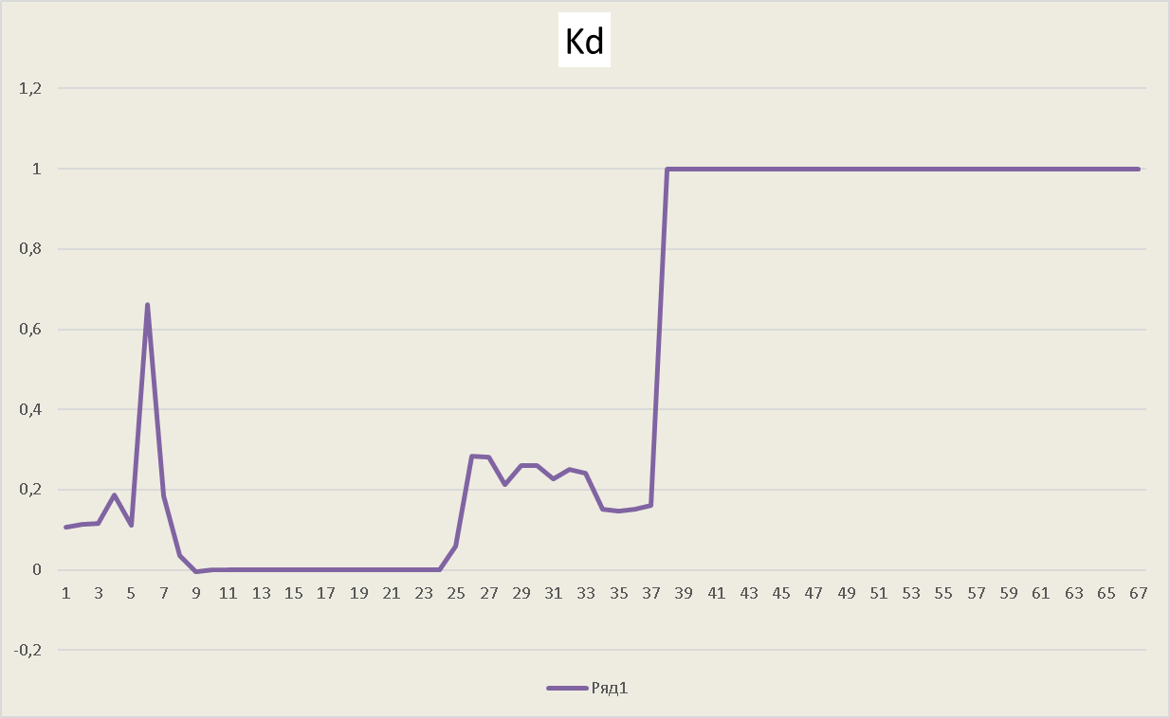
EPS-DM model – is used to value stocks by estimating projected earnings per share
School of Economics and Management
International Bachelor in Business and Economics
Saint-Petersburg 2025
The calculations of the basic values are the same as in the DDM-DM model, the only difference is the change in the value of the payout ratio (Kd = 1).
Key findings of the model:
If Apple now reinvests part of its profits in AI development, then in 2054+, when growth stabilizes, the company will pay out all profits to shareholders, so payout ratio = 1.
The fair value according to the EPS-DM model (325,57) is significantly higher than the market price, so it is assumed that the company will effectively use profits to grow and increase the value of shares. It may also mean that the stock is potentially undervalued by the market if the forecast for profit growth is justified.

Slide 7
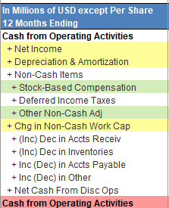
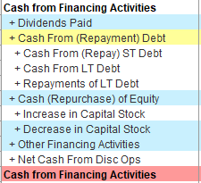
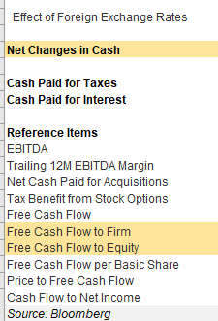
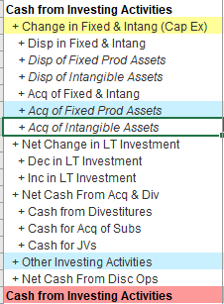
Structure of the lines
School of Economics and Management
International Bachelor in Business and Economics
Saint-Petersburg 2025
stock based compensation is included in future years. This is the cost of labor for the development of a product for which there is no profit yet.
repayment of the company's debt (DP)
Definition (DA): expenses that characterize the wear and tear of equipment or the transfer of the cost of this equipment to the final product. Reduces taxable profit, is included in the income Statement (Income Statement IS).
expenses accrued but not incurred
expenses have not gone away from the company
When a company buys back its shares, it decreases cash, which appears as a negative number on the cash flow statement
This is the amount of change in non-cash working capital for a specific period.
Net changes in Cash=CFOA+CFIA+CFFA
CapEx purchase: (Buildings and structures, Intellectual property, Equipment)
The amount of cash outflows for the acquisition of fixed production assets during a specific period
The EBIT value, which shows earnings before taxes
is used to generate cash flows to shareholders​
“water in the pool” model
to generate cash flows to the firm as a whole, i.e. to shareholders plus creditors​

Slide 8






FCFE-DM - is used to generate cash flows to shareholders
School of Economics and Management
International Baccalaureate in Business and Economics
Saint-Petersburg 2025
Revenue was forecast for 30 years as in the model DDM-DM
FCFE are calculated in 2 ways:
FCFE margins are calculated in 3 ways: for bloom, FCFE1 and FCFE2
For each year starting from 2025, the average values for FCFE margins (FCFE/Revenue) over the past 10 years are taken:
Based on the predicted average values of the FCFE Marins, the predicted values of the FCFE are calculated (Revenue * average FCFE margins )
Calculated the average value of the Shares Outstanding
Calculated the value of the discounted FCFE using the formula and found their sum
The fair value was calculated:

Slide 9
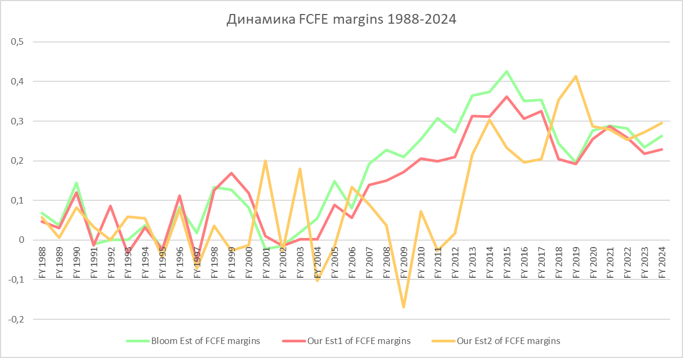
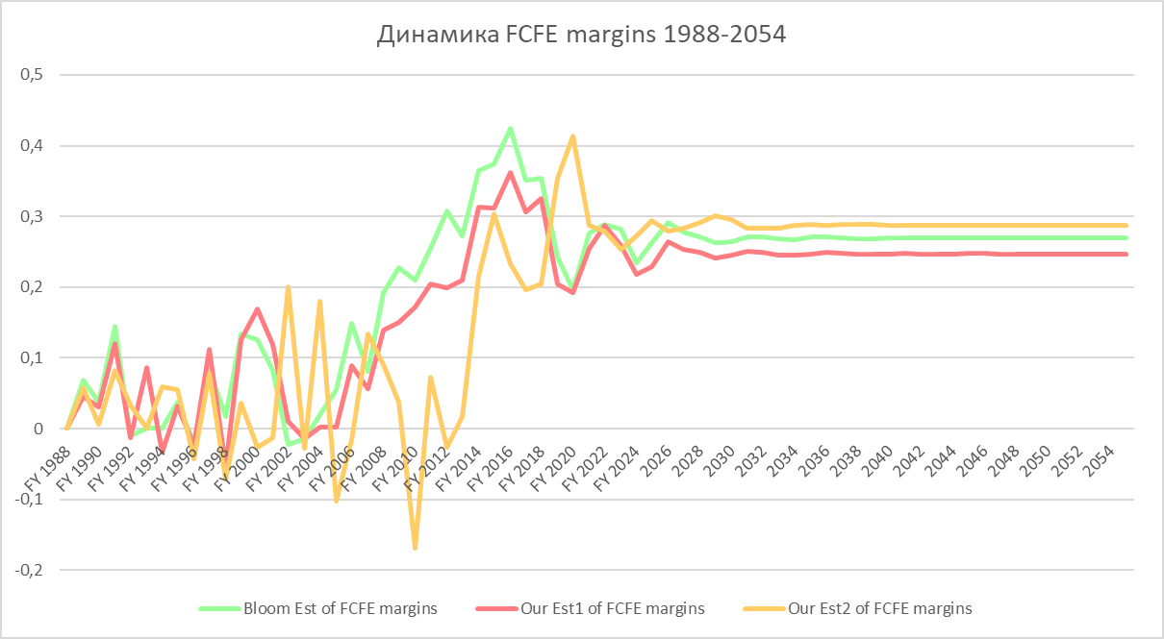
FCFE-DM: Line graph analysis
School of Economics and Management
International Bachelor in Business and Economics
Saint-Petersburg 2025
On the left are graphs of the dynamics of FCFE margins by year. The lower graph also shows the predicted values. The values in the first years up to 2008 constantly jumped up and down and remained on average at a low level (about 0.05). Since 2008 (after the mortgage crisis), the growth values begin to increase and remain at a high level until 2020 (about 0.35). After 2020 (Covid epidemic), the growth values are gradually decreasing, which is why the projected values are kept at an average level of about 0.275.
The forecast period

Slide 10
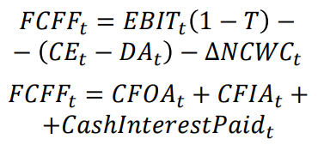




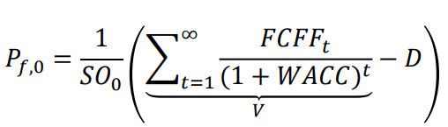
FCFF-DM - to generate cash flows to the firm as a whole, i.e. to shareholders plus creditors
School of Economics and Management
International Bachelor in Business and Economics
Saint-Petersburg 2025
Revenue was forecast for 30 years as in the model DDM-DM
EBIT values found and FCFF are calculated in 2 ways:
FCFF margins are calculated in 3 ways: for bloom, FCFF1 and FCFF2
For each year starting from 2025, the average values for FCFF margins (FCFF/Revenue) over the past 10 years are taken:
Based on the predicted average values of the FCFF Marins, the predicted values of the FCFF are calculated (Revenue * average FCFF margins )
Calculated the average value of the Shares Outstanding
The WACC values were calculated using the formula using E and D data from the Internet
Calculated the value of the discounted FCFF using the formula and found their sum
The fair value was calculated:

Slide 11
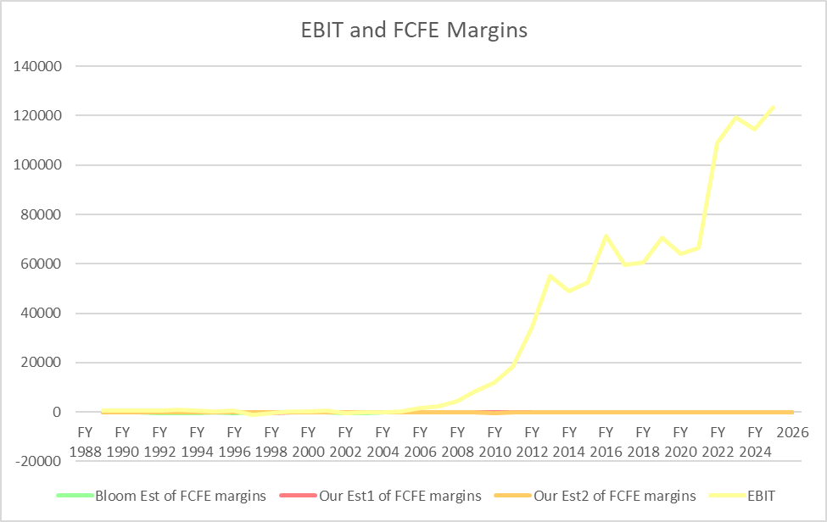
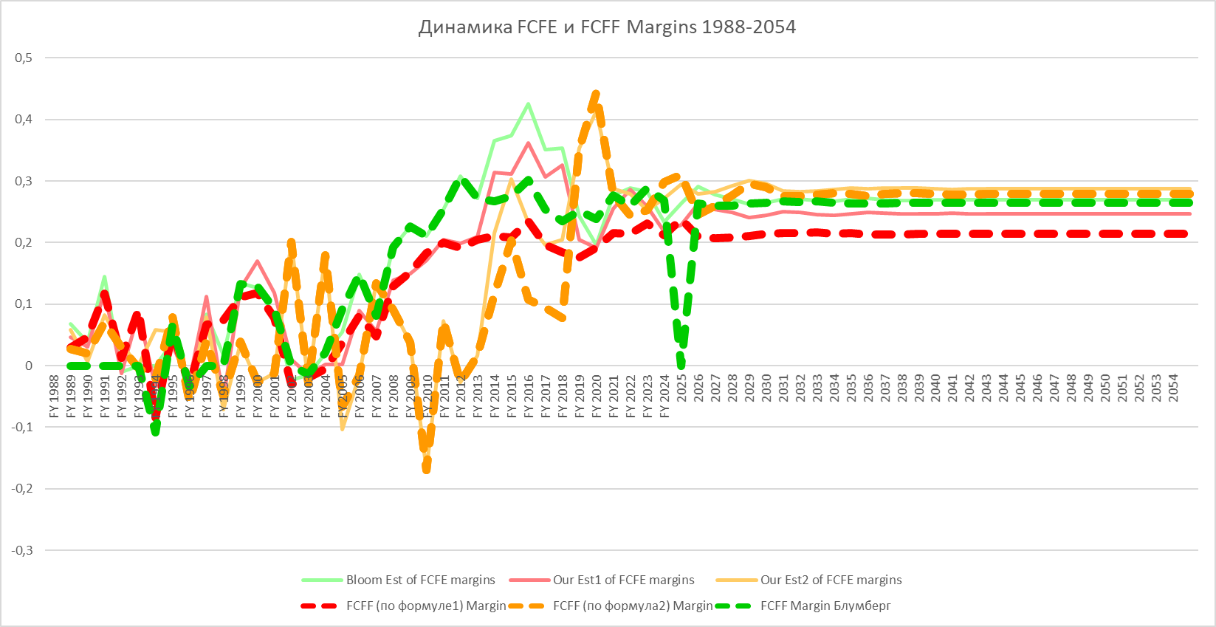
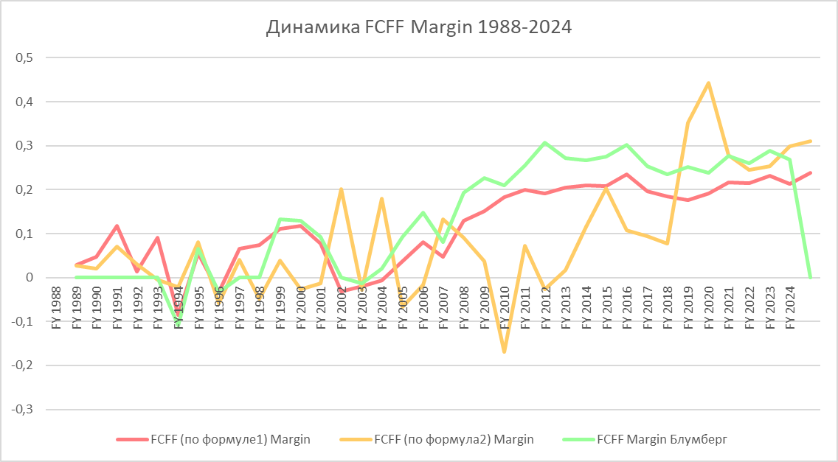
FCFE-DM and FCFF-DM Line graph analysis
School of Economics and Management
International Bachelor in Business and Economics
Saint-Petersburg 2025
The forecast period
The EBIT value, which shows earnings before taxes, has been increasing every year since 2006. This is around the same time when the FCFE and FCFF margins are starting to increase. This is logical since the shareholders' income is directly related to the company's profits.
The value of FCFE and FCFF margins are almost identical. Significant differences are observed only in 2013-2018, the FCFF model is not growing as fast and strongly as FCFE. This is due to the fact that both models are quite similar in terms of calculations, only the FCFF model also takes into account the cash flows of the creditors, because of this, it does not grow so fast and strongly.

Slide 12
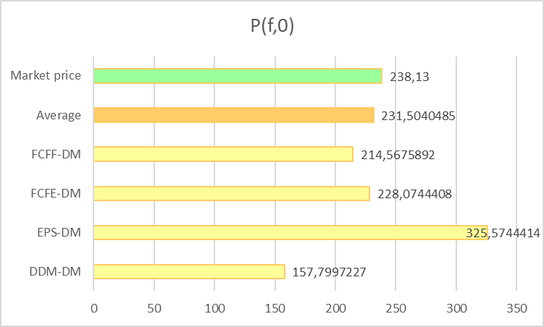
Comparison of model values
School of Economics and Management
International Bachelor in Business and Economics
Saint-Petersburg 2025
Four models – FCFE-DM, FCFF-DM, EPS-DM, DIV-DM – depending on the type of cash flow at their base, all give different results.
To understand which payment model is more suitable, you need to study the specifics of the company.
DIV-DM is a dividend discounting model, suitable when a firm pays stable and sustainable dividends that can be predicted.
EPS-DM is a net income per share discounting model used when net income is a good substitute for profit, and the investor does not plan to assume control of the company.
FCFE-DM is a model for discounting cash flow to equity, used when the company's dividend policy is unstable or when an investor has a controlling interest in the company.
FCFF-DM is a cash flow discounting model for a firm, used to estimate the total value of a firm, including equity and debt investors
Using the average fair value of all four models allows to get as close to the market value as possible (231 ~ 238)

